Slide 1
Machine Learning for Public Policy
Rayid Ghani

Slide 2
Goals of the course
Machine Learning methods and tools
Solve Policy problems using Machine Learning

Slide 3
Expectations
Computational Skills
Proficiency in linux (cmd line), Python, pandas
Math & Statistics Skills
Probability & Stats
Discrete Math
Linear Algebra
Data Skills
Dealing with data in txt files and databases (SQL)

Slide 4
Logistics
TAs
Labs
Office hours
Assignments
Weekly Reviews (due before lass every Tuesday)
Programming Assignments
Mid-Term (extended take-home assignment)
Project

Slide 5
Recommended Books
Data Science for Business by Provost and Fawcett
Good practical introduction to ML
Machine Learning by Peter Flach
Good introduction to algorithms/models/methods

Slide 6
Online Resources
Introduction to Statistical Learning http://www-bcf.usc.edu/~gareth/ISL/
Videos: https://www.youtube.com/user/dataschool/playlists?shelf_id=4&sort=dd&view=50
Mining Massive Datasets http://www.mmds.org/

Slide 7
Lectures

Slide 8
Machine Learning
“A computer program is said to learn from experience E with respect to some task T and some performance measure P, if its performance on T, as measured by P, improves with experience E.”

Slide 9

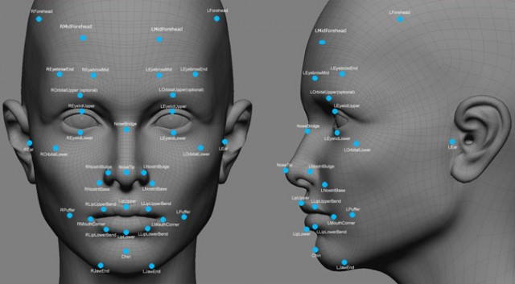

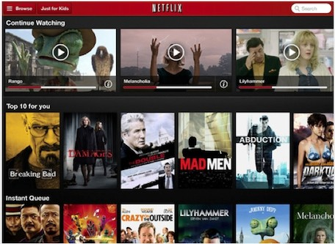
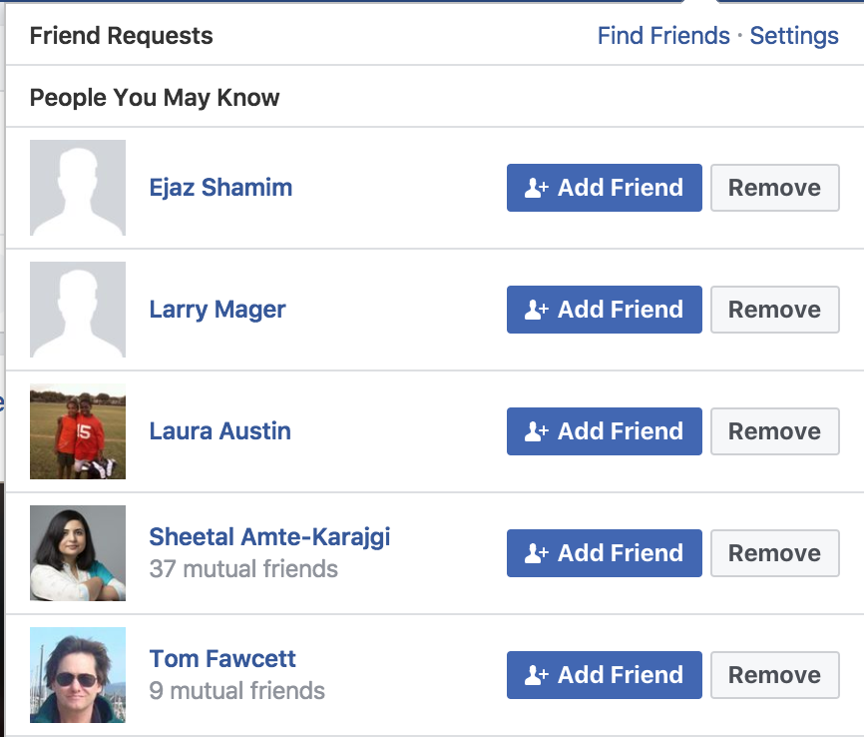
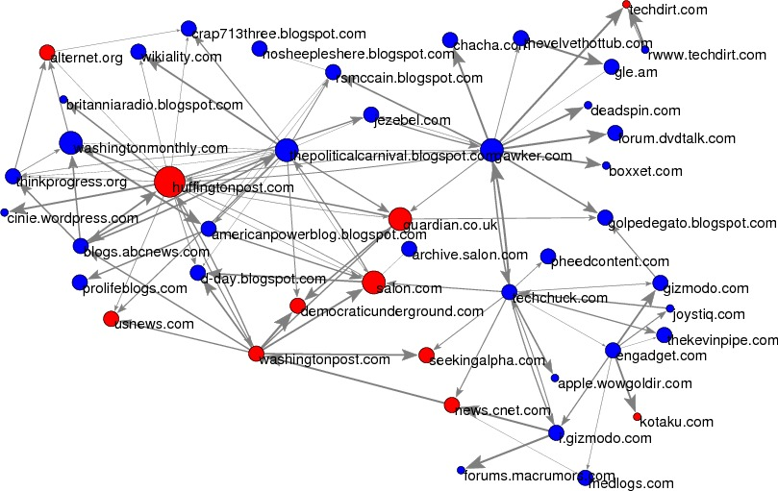
Notes:
Usps
Amazon/netflix - recommender
Advertising
Health
Autonomous cars

Slide 10
Why Machine Learning?
Goal: Adaptive and Scalable systems that are Cost-Effective to build and maintain
Rules-based systems are rigid and expensive
Lots of data is available to “train” the system

Slide 11
Machine Learning Benefits
The only way to solve problems
Magic
Data-Agnostic
Notes:
Needs to be combined with other methods
Features are important. The expert still needs to do work in defining the problem, generating features, selecting models, evaluation criteria
Without good data, models are bad. Bias, size, etc.

Slide 12
Machine Learning Benefits
The only way to solve problems
Magic
Data-Agnostic
Notes:
Needs to be combined with other methods
Features are important. The expert still needs to do work in defining the problem, generating features, selecting models, evaluation criteria
Without good data, models are bad. Bias, size, etc.

Slide 13
Types of ML tasks for Policy Problems
Description (Understand the past)
Detection (Anomalies, Events, Patterns)
Prediction (Predict the Future)
Behavior Change (Causal Inference)

Slide 14
Programming Assignment

